Slide 1

Webinar: Importance of Reporting Adverse Events to SAHPRA
JHB Health District
27th September 2023
Hethel Chouhan

Slide 2
Side effects experienced at Jhb Health Facilities

Slide 3
EXAMPLES OF ADRs REPORTED
Type of report | Suspected drugs | Reaction | outcome | reporting facility
ADR | Biotech Enalapril 10mg tabs | Persistent cough | Discontinued suspected drug and replaced with Amlodipine 5mg tabs | Lillian Ngoyi
ADR | Mylan TLD | Impaired renal function (Creatinine: 41) | Discontinued suspected drug and replaced with Dumiva® Abacavir+Lamivudine+ Dolutegravir | Itereleng
ADR | TLD (Manufacturer not specified) | Impaired renal function (eGFR decreased) | Discontinued suspected drug and replaced with Dumiva® Abacavir+Lamivudine+ Dolutegravir | Itereleng
ADR | Aspen HCTZ 12,5mg tabs | Lowered BP | Discontinued suspected drug | Itereleng
ADR | GenX Pharma Acriptega® (TLD) | Impaired renal function (Creatinine: 131) | Discontinued suspected drug and replaced with Abacavir (+ Lamivudine + Dolutegravir) | Itereleng
ADR | TLD (Manufacturer not specified) | Impaired renal function (Creatinine: 136, eGFR: 49) | Discontinued suspected drug and replaced with Abacavir (+ Lamivudine + Dolutegravir) | Itereleng
ADR | Aspen HCTZ 12,5mg tabs | Possible impaired renal function (eGFR: 49) | Discontinued suspected drug and replaced with Amlodipine tabs | Itereleng
ADR | Aspen HCTZ 12,5mg tabs | Fluid overload | Discontinued suspected drug and replaced with Furosemide | Itereleng
ADR | Cipla TLD, Aspen HCTZ 12,5mg | Impaired renal function (Creatinine: 107) | Discontinued suspected drugs and replaced with Abacavir and Enalapril | Itereleng
ADR | Cipla TLD | Impaired renal function (Creatinine: 152) | Discontinued suspected drug and replaced with Abacavir + Lamivudine + Dolutegravir | Itereleng
ADR | Aurobindo TLD | Impaired renal function (Creatinine: 186) | Discontinued suspected drug and replaced with Abacavir + Lamivudine + Dolutegravir) | Itereleng
ADR | Aspen HCTZ 12,5mg tabs, Unimed Metformin 850mg | Impaired renal function (Creatinine: 571, eGFR: 9) | Discontinued suspected drug and replaced with Actraphane | Itereleng
ADR | Zidovudine (Manufacturer not specified) | Impaired renal function (Creatinine: 202) | Discontinued suspected drug and replaced with Abacavir | Itereleng

Slide 4
EXAMPLES OF ADRs REPORTED
Type of report | Suspected drugs | Reaction | outcome | reporting facility
ADR | TLD (Manufacturer not specified) | Impaired renal function (Creatinine: 107) | Discontinued suspected drug and replaced with Abacavir (+ Lamivudine + Dolutegravir) | Itereleng
ADR | Mylan Atroiza® (TEE) | Impaired renal function (Creatinine: 201, eGFR: 33) | Discontinued suspected drug and replaced with Abacavir + Lamivudine + Dolutegravir | Itereleng
ADR | Hetero Combozil® (AZT + 3TC) | Impaired renal function (Creatinine: 147, eGFR: 33) | Discontinued suspected drug and replaced with Abacavir + Lamivudine + Dolutegravir | Itereleng
ADR | Aspen HCTZ 12,5mg tabs | Impaired renal function (Creatinine: 153, eGFR: 29) | Discontinued suspected drug and replaced with Amlodipine 10mg | Itereleng
ADR | Aspen HCTZ 12,5mg tabs | Impaired renal function (Creatinine: 401, eGFR: 10) | Discontinued suspected drug and increased dose of Enalapril | Itereleng
ADR | Mylan TEE, Aspen HCTZ 12,5mg | Impaired renal function (Creatinine: 134, eGFR: 34) | Discontinued suspected drug and replaced with Abacavir (+ Lamivudine + Dolutegravir) | Itereleng
ADR | Aspen HCTZ 12,5mg tabs | Hypotension | Discontinued suspected drug | Itereleng
ADR | Ascendis Atenolol 50mg tabs | Bradycardia | Discontinued suspected drug and replaced with Aspen HCTZ 12,5mg | Itereleng
ADR | Austell Enalapril 10mg tabs | Angioedema | Discontinued suspected drug | Itereleng
ADR | Aurobindo TLD | Impaired renal function (Creatinine: 135, eGFR: 35) | Discontinued suspected drug and replaced with Abacavir (+ Lamivudine + Dolutegravir) | Itereleng
ADR | Aurobindo TLD, Austell Enalapril 10mg | Impaired renal function (Creatinine: 243, eGFR: 26) | Discontinued suspected drug and replaced with Dumiva® (Abacavir/Lamivudine)+ Dolutegravir | Itereleng
ADR | Aurobindo Volutrip ®(TLD) | Impaired renal function (Creatinine: 181, eGFR: 27) | Discontinued suspected drug and replaced with Dumiva® (Abacavir/Lamivudine)+ Dolutegravir | Itereleng
ADR | J&J Covid-19 vaccine | Sudden onset of hot flushes, nausea and dizziness | No intervention | Protea South

Slide 5
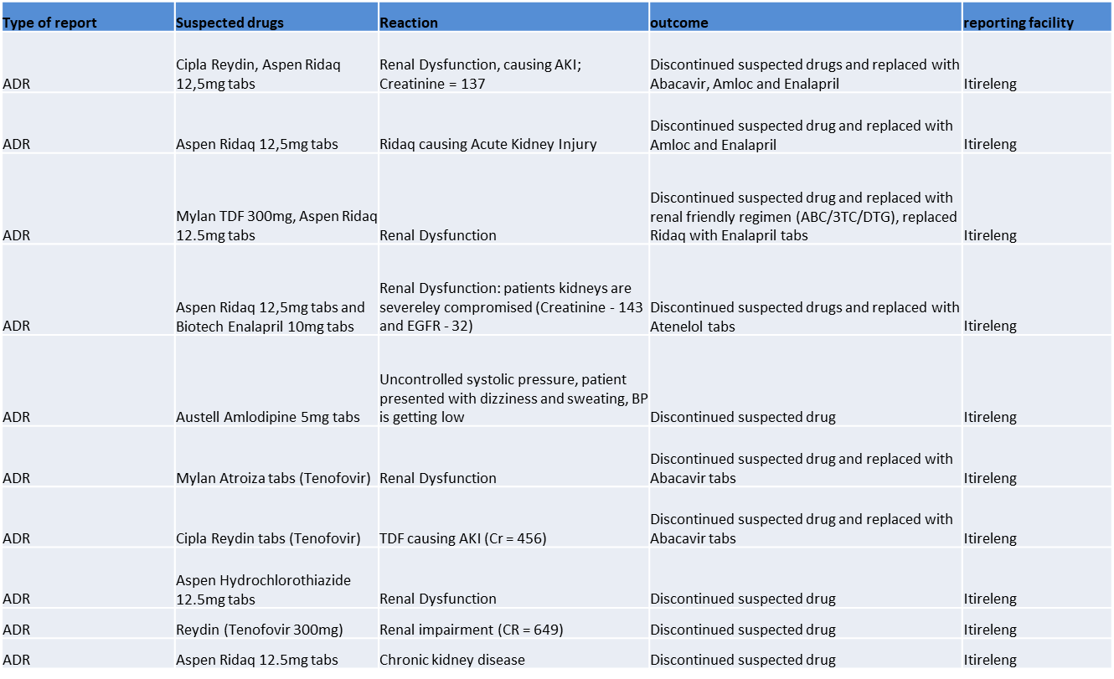
EXAMPLES OF ADRs REPORTED

Slide 6
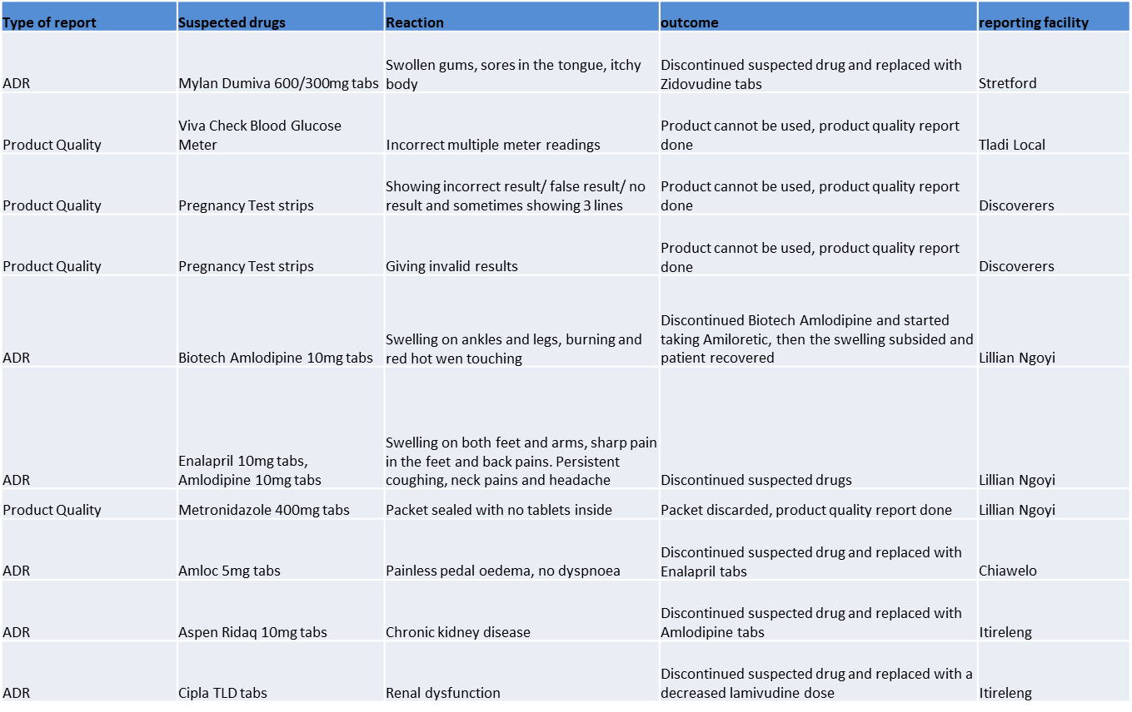
EXAMPLES OF ADRs REPORTED

Slide 7
What does Jhb Health District do to ensure patient safety with regards to side effects experienced?

Slide 8
Steps taken by JHB Health District
Monthly facility visits to monitor pharmacovigilance.
Checking that ADR Reports are done and submitted monthly.
Compilation of monthly ADR reports for NDoH and SAHPRA.
During Ideal Clinic Inspections: checking dispensing procedure such as correct labelling, directions given and counselling process.
During Covid, liaised with traditional healers to explain the importance of vaccinating, side effects of the vaccines and the impact of mixing medications with complementary alternative/ herbal medicines.
Checking of patient prescriptions to ensure correct medications prescribed as per diagnosis, correct dosages, duration of treatment, correct directions being given, patient allergies, warnings if necessary and any drug-drug interactions.
Taking interventions as required when any errors are discovered.
Regular PTC meetings with Drs, clinicians and pharmacists to discuss pharmacovigilance, provide trainings and feedback on reporting.

Slide 9


